Slide 1

An Introduction to
Teaching-as-Research (TAR)
UI-CIRTL TAR Cohort Session 1
October 18, 2023
Brian Smentkowski, PhD
Professor of Political Science and Founding Director, Center for Excellence in Teaching and Learning

Slide 2
Session 1: Description and Learning Goals
What is TAR and why does it matter?
Teaching-as-Research (TAR) is an evidence-based approach to reflective teaching and a Core Idea of the CIRTL Network.
Essentially, TAR looks at teaching as a research question, which encourages us to think in IF->THEN terms: “IF I do this ____ (an instructional innovation or technique), THEN I should see ____ (a change in student performance, engagement, interest, etc).”
It provides a framework for imagining, implementing, and analyzing the effects of a teaching idea or innovation on student learning.
As such, it links teaching to learning and provides evidence of instructional impact.
In this session, we will cover the basics of TAR and how curiosity and reflection improve teaching and learning.
Participation in this series sets you up for participation in the CIRTL TAR Summer Course.

Slide 3

CIRTL is…
The Center for the Integration of Research, Teaching, and Learning.
CIRTL was founded in 2003 as a National Science Foundation Center for Learning and Teaching in higher education and seeks to enhance excellence in undergraduate education through development of a national faculty committed to implementing and advancing evidence-based teaching practices for diverse learners.
CIRTL uses graduate education as the leverage point to develop a national faculty committed to implementing and advancing effective teaching practices for diverse student audiences as part of successful professional careers.
The goal of CIRTL is to improve the learning of all students at every college and university, and thereby to increase the diversity in STEM (and non-STEM) fields and … literacy.

Slide 4
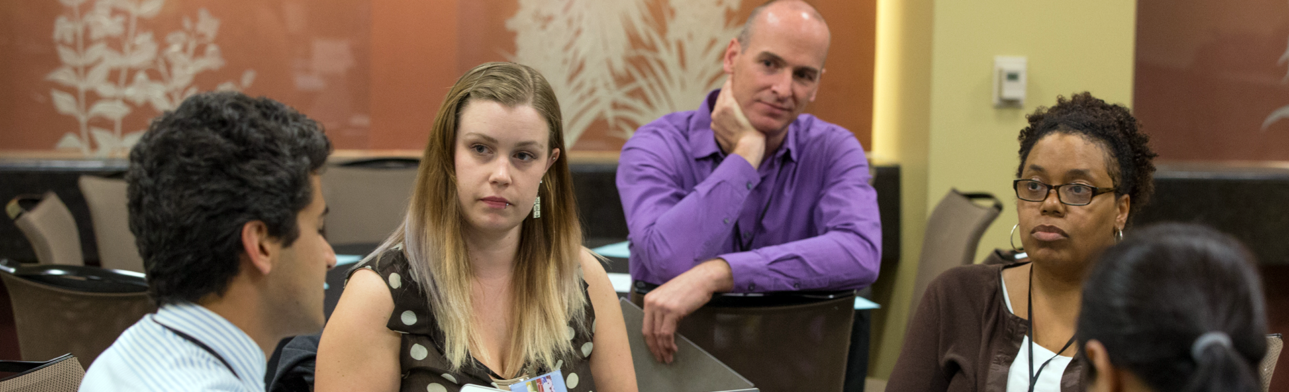
Core Ideas
Learning-through-Diversity
Learning-through-diversity capitalizes on the rich array of experiences, backgrounds, and skills among STEM undergraduates and graduates-through-faculty to enhance the learning of all. It recognizes that excellence and diversity are necessarily intertwined
*Teaching-as-Research*
Teaching-as-research is the deliberate, systematic, and reflective use of research methods by science, technology, engineering, and mathematics (STEM) instructors to develop and implement teaching practices that advance the learning experiences and outcomes of both students and teachers
Learning Communities
Learning communities bring together groups of people for shared learning, discovery, and generation of knowledge. To achieve common learning goals, a learning community nurtures functional relationship among its members.

Slide 5

TAR Basics
Teaching-as-Research transforms curiosity about learning into a research question that can promote improved learning experiences and environments for diverse learners.
While Teaching-as-Research may result in a Scholarship of Teaching and Learning, it is primarily focused on enriching the learning experiences of our students and our own practices.
Thusly conceived, TAR is a form of Scholarly Teaching. It is rooted in curiosity, informed by research, applied in practice, and refined through reflection.
A broader result is that TAR keeps us curious about learning and innovative in our teaching.

Slide 6
Exercise 1: Interests and Curiosities
What interests you most about teaching and learning?
What aspect of learning are you most curious about?

Slide 7
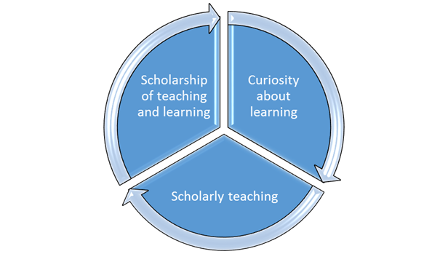
Distinctions and Potential Progressions
TAR is:
SoTL is:
Inspired by curiosity
Informed by research
Evidence-based
Organized
Systematic
Analytical
Critically reflective
Transformative to our teaching
Transformational to learning
“The systematic study of teaching and learning, using established or validated criteria of scholarship, to understand how teaching (beliefs, behaviours, attitudes, and values) can maximize learning, and/or develop a more accurate understanding of learning, resulting in products that are publicly shared for critique and use by an appropriate community.” (Potter and Kustra, 2011).
The major difference is that SoTL emphasizes going public –presenting and publishing-- with one’s findings
Scholarly Teaching and TAR are focused on the process of
understanding and improving learning.

Slide 8
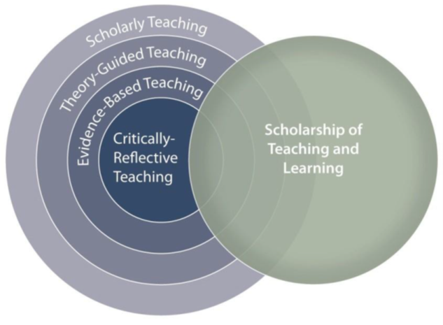
Simple and Complex Perspectives
(Potter & Kustra, 2011)
TAR

Slide 9
Exercise 2: Teaching and Learning
Teaching
Learning
What do you teach?
How do you teach?
Why?
How’s that working out?
What does learning look like?
Is it a process or a product?
Is your class structured around clearly identified learning goals?
How do you teach to accomplish those goals?
How do your activities, assignments, and feedback provide a pathway to accomplishing them?
What do you do to support or enhance learning?
Is there another way to get at / foster the learning?

Slide 10
Thinking Systematically: A 5 Step Process to TAR
Generate an idea
Review the literature
Design a study
Launch it
Collect data
Analyze data
Reflect

Slide 11
Five More Steps We Will Get Into More Deeply Next Time
Essential Steps
Step one:
Remain engaged in your discipline
Remain engaged in its scholarship
Think about ways your research can inform what you teach and how, and how your teaching can inform your research
Step two:
Think about how you can change some aspect of your class and/or your teaching in order to investigate its impact on learning
Think ahead about where and how you will find evidence of learning gains (Hint: SLOs and assessments)
Think about opportunities you can give your students to provide this evidence
Step three:
Develop a plan
Step four:
Implement an innovation
Observe learning
Analyze outcomes
Step five:
Reflect on your teaching, your students’ feedback, and the feedback of others
Make a change?
An Evidence and Assessment Based Approach
Where do we find the evidence of TAR-based scholarly teaching?
In general, we should see it:
In the design and delivery of the class
In critical reflection/observation tracking journals
In student and peer observation and evaluation of teaching
In particular, we should see:
A clearly defined question you seek to answer by making a change in your class
  A clearly stated innovation/intervention designed to address it
An organized plan for implementing it
Adequate attention before, during, and after the intervention
Appropriately selected methods of implementing, observing, and recording the impact of the intervention
Learning from and responding to the data
But don’t:
Turn your class into a laboratory
Get so caught up in the details that you forget that the goal is to engage students and enhance learning.

Slide 12

Looking Ahead
For next time, please start thinking about:
An aspect of learning you are most curious about,
A small change that can make a big difference, or simply
Something about your class –now or in the future– that you would like to experiment with or change.

